Slide 1
VALUATION CHALLENGES
IN REAL LITIGATION
Caroline Shea QC

Slide 2

Everyday valuation
Lending
Insurance
Asset management
Sale by mortgagee in possession

Slide 3

Everyday litigation
Restrictive covenants
Succession to 1986 Act tenancy
Boundary disputes
Breaches of covenant

Slide 4

When valuation and legal worlds collide

Slide 5

The usual suspects
Rent review
Lease renewal
Dilapidations – diminution in value
Section 84 applications to modify etc restrictive covenants

Slide 6
Common features of typical disputes involving valuation
Valuation exercise is dictated
  - Statute e.g. section 34 of the 1954 Act
  - Contract e.g. rent review clauses
Usually involves market in which similar transactions take place
  - Comparables/zoning
  - Market well understood
Exceptions
  Often follow in the wake of new technology e.g. data centres

Slide 7

Variables well known
Net net or net rent when devaluing comparables in 1954 Act lease renewal
Devaluing turnover rent in a comparable;
Whether/how to use published data eg quarterly tables
Whether/how to discount for passage of time/ location/other
Treatment of outliers
Features of market affecting hypothetical purchaser

Slide 8

Uncertainties
Performance of experts giving evidence (report and under cross examination)
Quality of counsel (written and oral advocacy)
Quality and experience of Court

Slide 9

The beautiful game
Regulation sized pitch
Fixed length contest
Regulation number of players
No moving of the goalposts

Slide 10

Relationship between valuer and counsel
Legal and valuation issues familiar to both
Question clearly defined
Expert report drives the case/issue
Expert acquaints counsel with location; local issues; local deals
Expert advises counsel on other side’s expert report

Slide 11

Extraordinary cases
Unique property
Unique circumstances
Unique claim
- One off/untested contract
- Extension of established principles to
new category
- Nuisance
- Negligence
Unique damage

Slide 12

Hang on to your hats …

Slide 13

Trouble ahead …
Issues less familiar/well defined
Speed and difficulty variable
Legal issues can merge into valuation issues
One-off valuation to perform

Slide 14
Challenges
Clarity of instructions
Focus of evidence
Scarcity/absence of comparables
Evidence of market behaviour
Instinct (informed) vs text book approach

Slide 15
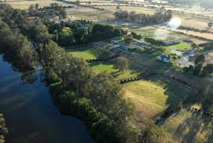
Case study
Trophy estate
International reputation
First time to market for 30 years
Mixed agri/equine/residential use
Main house(s)/equine buildings/agri buildings/tied cottages
Marketing literature produced/advert space reserved
Agents open day
Guide price iro £26m

Slide 16
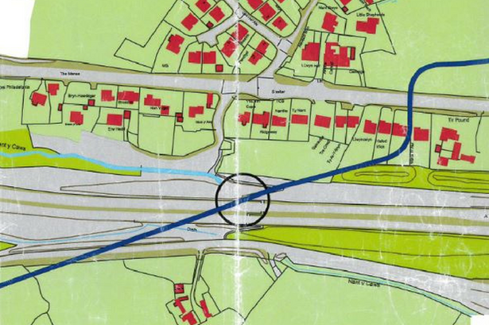
The problem
Oil pipe running under estate
Third party trespassers
Oil leak – 150,000 litres
Deed of grant
Indemnity for damage arising from use of pipe

Slide 17

Outcome
Sale proceeded
No competitive bidding
Aggressive purchaser bought majority
Remainder went in lots to unrelated purchasers
Total sum achieved around £25.5m

Slide 18

Answering the right question
Derived from legal team
Common law/contract/statute
In light of what has happened
Crucial for Counsel and valuer to work together at this early stage
Asking (or answering) the wrong question could scupper potential claim or lead to unsustainable claim

Slide 19

The valuation issue
NOT (completely) hypothetical valuation:
value of estate with oil spill at a fixed point in time
compared to
value of estate without oil spill at the same point in time.
BUT WHETHER
price that would have been achieved had there been no oil spill
was higher than
the price that was actually achieved …
AND IF SO WHETHER
that difference was due to the oil spill

Slide 20

Approach to valuation - problems
No precedent
No (direct) comparable(s) because of uniqueness of property
Uniqueness of claim under indemnity
Know what did happen in factual world with oil spill
Have to identify what would have happened in counterfactual world without oil spill

Slide 21

Red book
Role of red book
Bound to follow?
Bound by definitions?
Red book result vs expert opinion based on experience of actual transactions

Slide 22
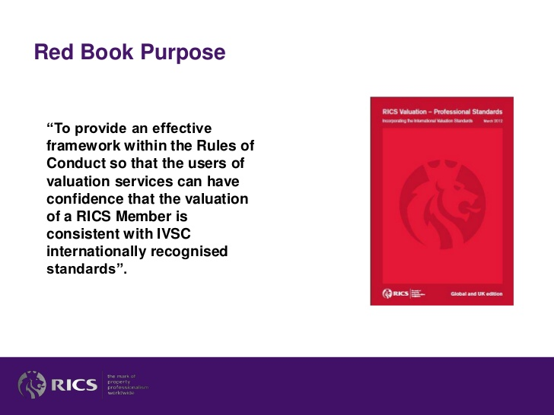
Red Book Puropse

Slide 23
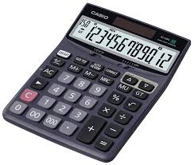
Valuation framework
Open market value defined
Excludes marriage value, also defined
Excludes special purchasers, also defined
Does that mean that the Red Book dictates the answer?
Calculate OMV in accordance with RB definition
+ marriage value, if present, as defined by RB definition
+ any special purchasers as defined by RB
= value of property in hypothetical world (without oil spill)?

Slide 24
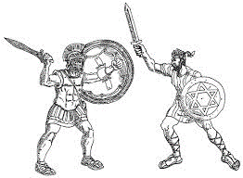
Red Book vs Role as Expert
Duty to assist the court
Duty to answer question(s) as instructed
Slavish adherence to red book
  - eliminates deployment of expertise (other than expertise at
  applying Red Book)
  - fetters expert’s discretion
  - may even conflict with duty to court where expert’s opinion
  differs from a strict application of the Red Book

Slide 25

Real conflict?
Experts exempt
- prescriptive approach may not “work” in all
situations
- where there is conflict, duty to court prevails
Purpose of report to be expressed
- opinions/answers are context dependent
- avoids slavish adherence, engages expertise

Slide 26

Answering the question(s)
WHETHER
price that would have been achieved had there been no oil spill
was higher than
the price that was achieved …
AND IF SO WHETHER
that difference was due to the oil spill

Slide 27
Methodology
Component value
Marriage value (if any)
Reasonable range of market value
Factors affecting where in the reasonable range the market will settle
Assess the market for the property
Competitive bidding pushes market value to top of reasonable range
Premium bid from purchaser with strongest desire to acquire unique estate
Identify range of premium found in market
Choose conservative point within range to apply
Discount for risk/unforeseen event(s)

Slide 28

Off piste
Non Red Book elements
- Reasonable range
- Competitive bidding (sed quaere)
- Premium value/bid
- Discount for uncertainty
Justified by reference to
- actual experience
- comparable evidence in relation to some elements
- answering the question

Slide 29

Difficulties (1): Counsel
Counsel’s perspective – technician (court craft)
  - First impressions
  - Cross examination (them and us)
  - Evidence
  - Closing submissions
  - Outcome (judgment)
Valuer’s perspective (expertise)
- Experience
- Inside out knowledge
- Explaining in lay terms what seems self evident

Slide 30

Difficulties (2): the other side
Separated two areas of expertise
Marketing expert not understanding duty to court
Relied on evidence of what actually happened - all came from oil spill world
Valuer dependent on marketing expert
- assessment of property/market
- performance under cross examination
Valuer adhered to rigid market value definition

Slide 31

Which approach was correct?

Slide 32

Lessons
Identifying the question
Report writing
Applying your expertise (reality check)
Imagination (what if?)
Relationship with Counsel
Resilience

Slide 33
Relationship with Counsel
Early involvement
Assume nothing, explain everything
Allow yourself to be tested
Give the process enough time
On the same side

Slide 34

Finishing line
Aim to settle early
Keep eyes on the finishing line
Stay robust
Sometimes it takes getting to court to focus the other side on the risks
Enjoy the ride

